Slide 1
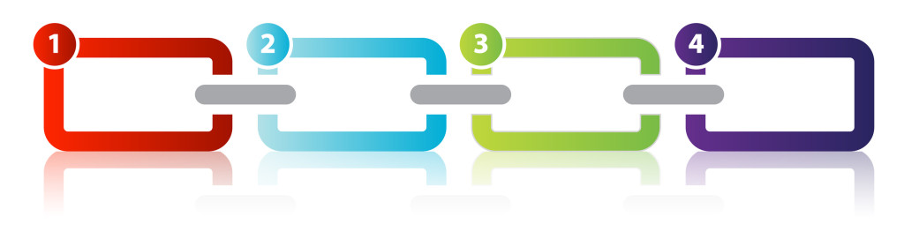
Design Pattern
Chain of Responsibility

Slide 2
Introduction
Design patterns are typical solutions to common problems in software design.
Chain of Responsibility is one of the Behavioral Design Pattern introduced by Gang of Four.
It is used to achieve loose coupling in software design, where a request from client is passed to a chain of objects to process it.

Slide 3
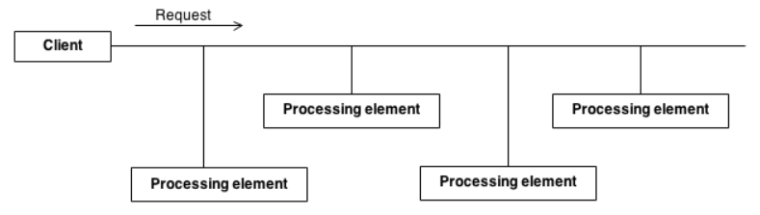
Need
There can be potentially variable number of "handler" or "processing element" or "node" objects, and a stream of requests that must be handled.
Need to efficiently process the requests without hard-coding handler relationships, handler precedence, or request-to-handler mappings.

Slide 4
Working
Processing elements are encapsulated inside a "pipeline" abstraction.
Clients "launch and leave" their requests at the entrance to the pipeline.
Chains the receiving objects together, and then passes request messages from object to object until it reaches an object capable of handling the request.
The number and type of handler objects isn't known a priori, they can be configured dynamically.
Uses recursive composition to allow an unlimited number of handlers to be linked.
Chain of Responsibility simplifies object interconnections.
"Safety Net" is created to "catch" any requests which go unhandled.

Slide 5
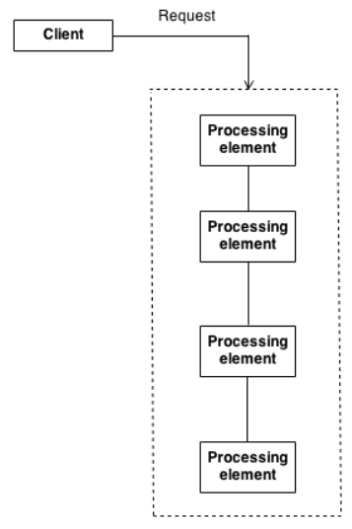

Slide 6
Participants
Handler :
This can be an interface which will primarily recieve the request and dispatches the request to chain of handlers. It has reference of only first handler in the chain and does not know anything about rest of the handlers.
Concrete handlers :
These are actual handlers of the request chained in some sequential order.
Client :
Originator of request and this will access the handler to handle it.

Slide 7
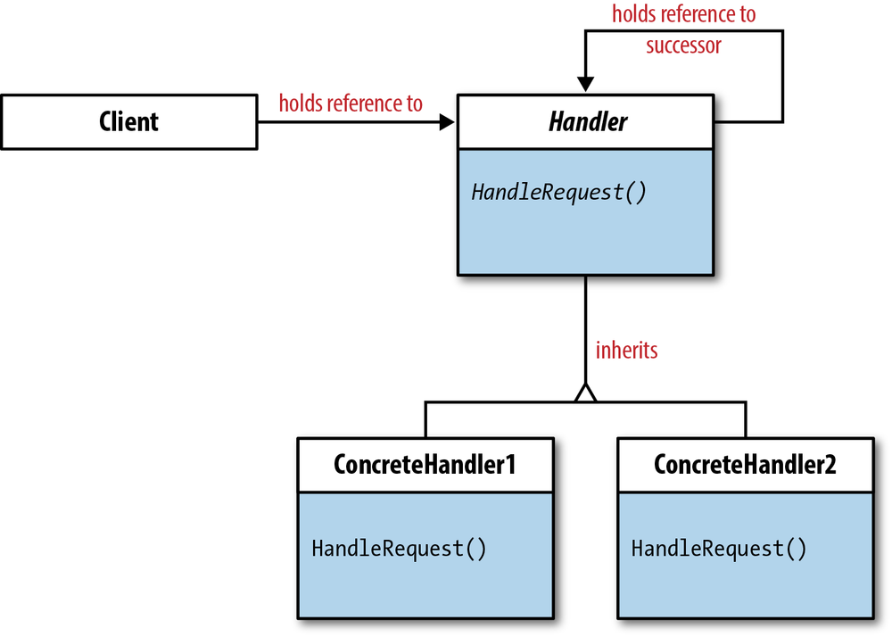
UML Diagram

Slide 8
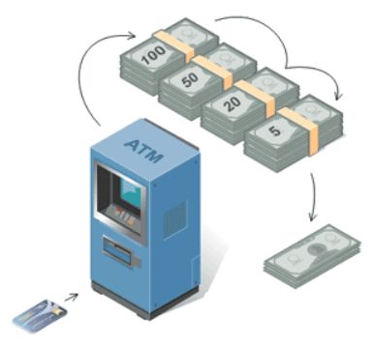
Real Life Example
ATM uses the Chain of Responsibility Pattern in money dispensing mechanism.
User enters the amount to be retrieved and the ATM dispense amount in terms of defined currency bills such as 100 Rs, 50 Rs, 20 Rs, 5 Rs, etc.

Slide 9
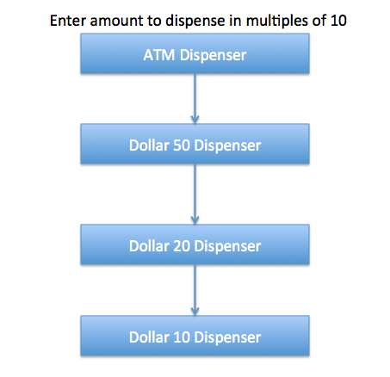

Slide 10
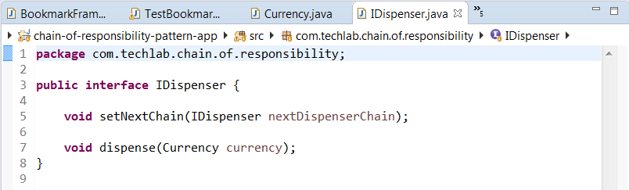
Code Snippet

Slide 11
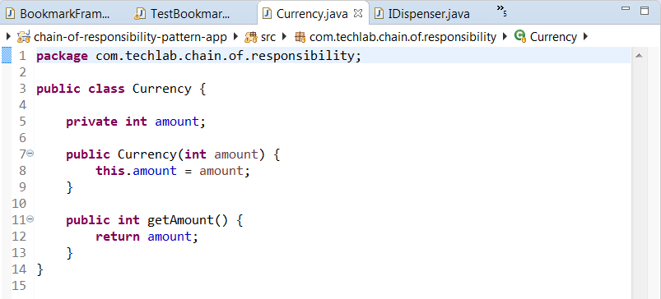
Code Snippet

Slide 12
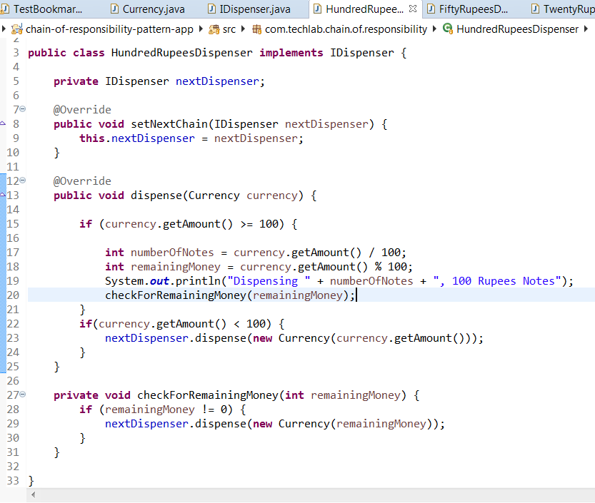
Code Snippet

Slide 13
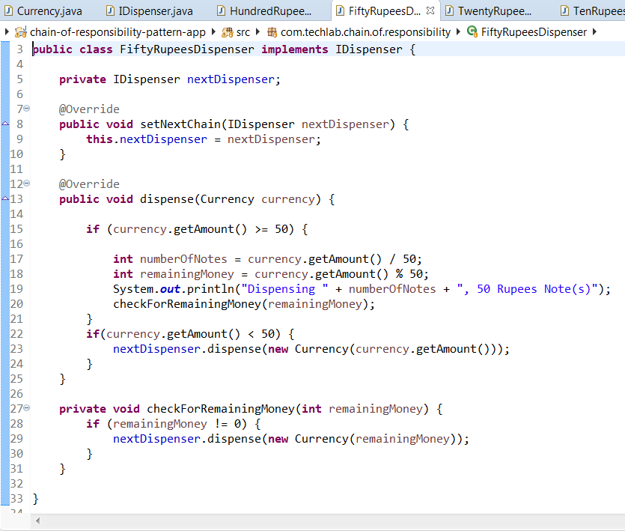
Code Snippet

Slide 14
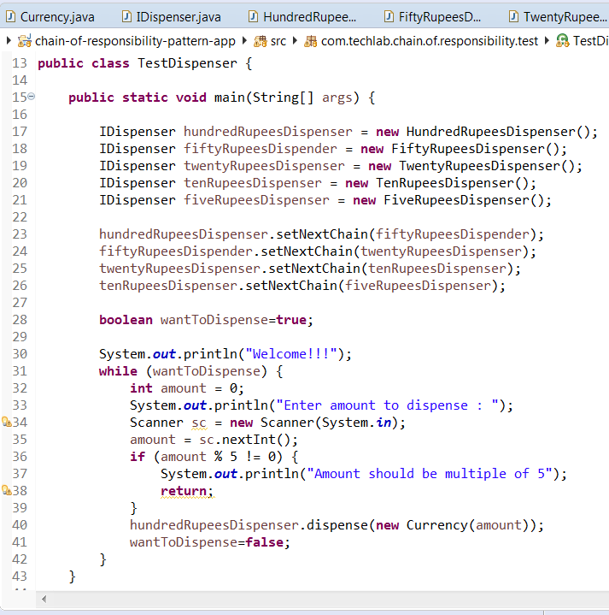
Code Snippet

Slide 15
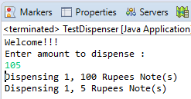
Code Snippet

Slide 16
Uses
To avoid coupling a request’s sender and receiver
Multiple objects to be determined at runtime, are candidates to handle a request
Don’t want to specify handlers explicitly in your code
When you want to issue a request to one of several objects without specifying the receiver explicitly.

